Slide 1
Expectation Maximization Algorithm
CSIE
Notes:
Hello everyone,
In this session, I will explain about the Expectation Maximization Algorithm or EM algorithm

Slide 2
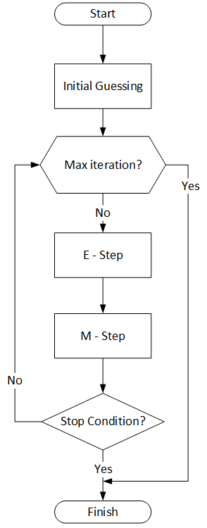
EMA OUTLINE
The Key Value
A coin experiment
EM Algorithm
Initial Guessing
The E-Step
The M-Step
Results
https://bit.ly/EM_explanation
Notes:
In this session, I will covers the following:
First, the key value, of when WE NEED TO use EM ALGORITHM
Second, we use a coin experiment example to explain how the EM works
Third, the algorithm itself, which is the iteration process like you can see in the flowchart in the right
which starts with initial guessing, then estimating the E-step, and M-step until either max iteration or stop condition has been met
Then, the last, the result of the coin experiment example using EM algorithm

Slide 3
THE KEY VALUE
1
Is this really what you need?

Slide 4
WHEN WE NEED TO USE EM ALGORITHM?
incomplete dataset (e.g. did not have any groups/labels in your data),
but need to estimate the parameter for that group/labels.
It called “Latent” variables, means hidden
Notes:
WHEN WE NEED TO USE EM ALGORITHM?
It is when you have incomplete dataset (for example, did not have any groups/labels in your data), but you need to estimate the parameter for that group/labels.
Yet it is never observed, but believed to be important for explaining the data.
In this case, it called “Latent” variables, or it means hidden variables

Slide 5
THE COIN EXPERIMENT
2
A Concrete example

Slide 6

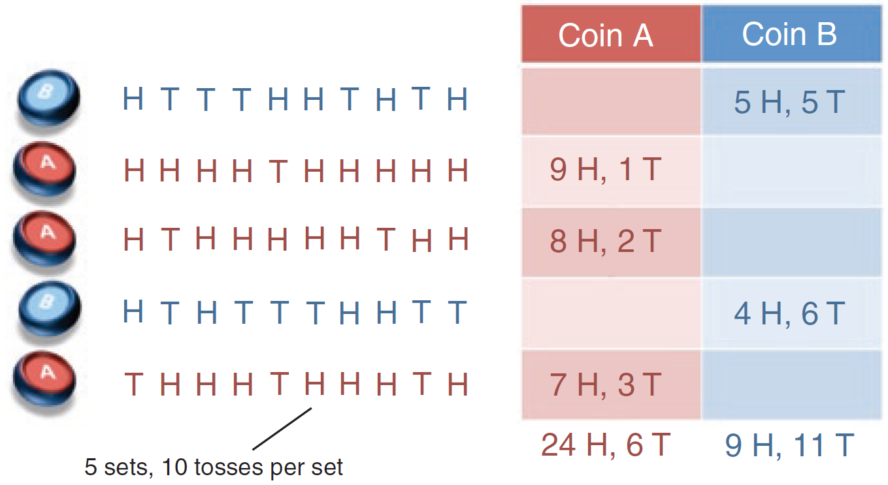
SETS OF COIN TOSSES
For example,
Estimate the head probability of two coins with 5 records where:
Chosen one of the two coins at random.
Flipped that same coin 10 times.
Repeat point 1 and 2, 5 times
Notes:
This is an example to explain how EM Algorithm works
Suppose,
your friend has posed a challenge to you, to estimate the head probability of two coins with 5 records where:
He chosen one of the two coins (A or B) at random.
Then he flipped that same coin 10 times.
Repeat point 1 and 2, 5 times

Slide 7

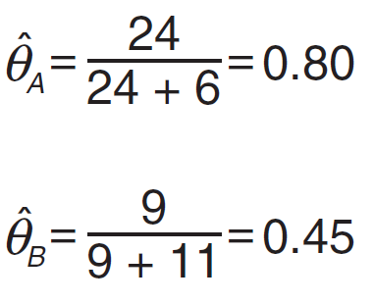
THE INCOMPLETE DATA
How to estimate of head probability (θ) of each coin?
?
?
5 sets, 10 tosses per set
Notes:
Here how the record looks like.
We can see here that we only have 5 sets of 10 times coin tosses
However, we do not know which coin is used for each set.
Then...
How can you provide a reasonable estimate of head probability (θ) of each coin?

Slide 8
THE COMPLETE DATA
Maximum likelihood:
Input
# of heads using coin A
θ_{A} =
total # of flips using coin A
^ Output
Notes:
on another occasion,
IF we know everything about the input,
we could say we have the complete data set,
Then, our problem is pretty easy,
we just need estimate the head probability of each coin using maximum likelihood.
For coin A, it is the number of heads using coin A (which is 24),
divided by the total number of flips using coin A (it means Head + Tail, which is 24 + 6)
So we have 0.8 for coin A.
And the similar calculation for coin B will get 0.45

Slide 9
EM ALGORITHM
3
A solution for incomplete data

Slide 10
THE INCOMPLETE DATA
How to estimate of head probability (θ) of each coin?
latent
P₁
P₂
P₃
P₄
P₅
?
?
5 sets, 10 tosses per set
Notes:
Let’s back to the first problem: IF, we don't see which coin is used for each set.
Here, We have 2 hidden parameters, that we don’t know or can’t calculate directly, which are:
The identity of coin A & B (The coin observation) for each set
The Head Probability of each coin biases (Objective)

Slide 11
HOW TO SOLVE WITH EM ALGORITHM
8H 2T
8H 2T
E-Step
P(E|ZA)
P(E|ZB)
0.12
0.04
STEP
3
STEP
2
8H 2T
θA=0.6
θB=0.5
θA
θB
P(ZA|E)
P(ZB|E)
A : B
73% : 27%
Initial Parameters
Mutual dependent variables
STEP
1
update
STEP
4
HH
HHHHHHH
HHHHHH
H
HHHHH
HHH
HH
HH
HHH
HH
1st iteration
M-Step
θA=0.71
θB=0.58
STEP
5
Notes:
Based on our situation, The EM Algorithm could help us solve our problem.
To get the bigger picture, the EM Algorithm could be explained by using this diagram,
Step 1: Initial Parameter
Before we begin, we need to guess the initial parameter,
or in this case, the head probability for each coin (theta A and theta B)
For example 0.6 for coin A and 0.5 for coin B
Step 2: Then at the beginning of the first iteration, we have initial value for each coin in this step 2.
In the EM algorithm process, it is work by continuously updating the variables in step 2, which have the mutual dependencies with the formula in step 4.
It means that variables on step 2 are updated based on estimation on step 4, and vice versa,
And where variables on step 4 also updated based on step 2.
That’s why the EM doesn’t work if we don’t set the initial values.
Step 3:
Then in the step 3, we estimate the likelihood for each set (we call it the E).
Or we could say, how much likelihood probability for each set E is occur using coin A and coin B
For example, in a set of 8 heads and 2 tails, the likelihood of coin A is 0.12 and coin B is 0.04
Step 4:
Then in the step 4 we calculate the ratio of the likelihood in each set based on step 3
It means that which coin is likely to be used in that set.
For example, in step 3, we have to compare 0.12 and 0.04
So that we may have the ratio of coin A and B is 73% to 27%
Step 5:
Then in the step 5, we split the number of Head in each set, based on the ratio on step 4,
Then we could have the estimated number of H and the estimated number of tosses for each coin
For example in the first iteration, the results show that the head probability coin A is 0.71 and coin B is 0.58
Which later are used to update the current parameter, or the head probability for each coin (theta A and theta B)

Slide 12
INITIAL GUESSING
3A
A solution to get started

Slide 13
INITIAL PARAMETER
Overview
STEP 1
0.6
0.7
0.6
OR OR
0.5
0.5
0.4
We will choose this as our initial parameter
Notes:
Ok, now, we begin with step 1, guessing the initial parameter
Because EM need an initial value to be able to do the estimation,
Then In this step, we need to guess the initial Head Probability for each coin....
It doesn’t need to be accurate, as we don’t know about it.
any probability between 0 and 1 is ok
For example, in this case we use:
0.6 for Coin A, and 0.5 for coin B
It means for coin A, it has 0.6 head probability and 0.4 tail probability,
While coin B, it has the same 0.5 probability for head and tail.

Slide 14
FIRST ITERATION
Overview
STEP 2
P₁
P₂
P₃
P₄
P₅
0.6
Initial value
0.5
5 sets, 10 tosses per set
Notes:
In our problem, we have set the initial value of Head Probability of each coin,
0.6 for theta A and 0.5 for theta B
This will be the theta value for the first EM iteration.

Slide 15
THE E-STEP
3B
Hidden parameter calculation

Slide 16
THE CONCEPT OF E-STEP
Overview
8H 2T
Coin A Likelihood: 0.1209
0.6
Showing 8H 2T
Coin B Likelihood: 0.0439
0.5
Comparing coin A and B
8H 2T → HHHHHH HH
73% Head to A
27% Head to B
Notes:
The basic concept of E-Step is to estimate the expected value of hidden variables,
based on the current values of each parameter.
For Example:
we already choose 0.6 for coin A and 0.5 for coin B, as the current parameter
if there is a set of 8 Heads and 2 Tails,
Then in this case, coin A has likelihood probability of 0.12 to showing a set of 8 Heads 2 Tails
While coin B is only has 0.04 likelihood probability
Then after we calculate the ratio of coin A and B,
Then we could split the number of Head based on the ratio
For example, coin A has 73%, then, the 73% of 8 heads will go to coin A,
so it like around 6 Heads to coin A and 2 Heads to coin B

Slide 17
CALCULATING THE MAXIMUM LIKELIHOOD (Page 1)
Overview
STEP 3
what is the probability that these flips came from coin A and coin B?
Let's call this set as “E”, and the coin A will be “Z_{A}” and B will be “Z_{B}”.
L(p | x) = p^{x}(1−p)^{n−x}
n!
Where:
n is full trial (total coin tosses)
p is to be estimated (head probability)
x is the successed trial (head occured)
x!(n−x)!
Notes:
The third step of our EM, is calculating the likelihood, or probability for each coin, to show a particular set E.
In this coin case, we could use a binomial random variable to estimate it.
Then using this formula, we could estimate the likelihood based on the head probability of a coin and the number of head occurred.

Slide 18
CALCULATING THE MAXIMUM LIKELIHOOD (Page 2)
Overview
STEP 3
8H 2T
The equation of probability of seeing these flips would be:
P(E|Z_{A}) = P(HTHHHHHTHH | Coin A chosen) = 0.6⁸ 0.4² = 0.1209
P(E|Z_{B}) = P(HTHHHHHTHH | Coin B chosen) = 0.5⁸ 0.5² = 0.0439
10!
8! 2!
10!
8! 2!
Notes:
Then for a full implementation, this is what we get
for a set with 8 heads and 2 tails,
Coin A has a likelihood of 0.12 to come up with this set
And coin B likelihood is 0.04 to come up with this set

Slide 19
CALCULATING THE TOTAL PROBABILITY (Page 1)
Overview
STEP 4
8H 2T
Then to calculate the total probability for all the coins, it could calculate based on Bayes' theorem and the law of total probability.
P(Z_{A} | E) = P(Z_{B} | E) =
P(E | Z_{A} )
P(E | Z_{B} )
P(E | Z_{A} ) + P(E | Z_{B} )
P(E | Z_{A} ) + P(E | Z_{B} )
Notes:
Then after that, we need to estimate that
for a set of 8 Heads and 2 Tails,
which which coin is likely to be used in that set.
Based on Bayes' theorem and the law of total probability,
We could calculate coin A by dividing the likelihood of coin A, with the total likelihood from coin A and B
And similar method for the coin B.

Slide 20
CALCULATING THE TOTAL PROBABILITY (Page 2)
Overview
STEP 4
8H 2T
73% chance it using coin A
P(Z_{A} | E) = P(Z_{B} | E) =
0.1209
0.0439
0.1209 + 0.0439
0.1209 + 0.0439
= 0.733
= 0.266
Notes:
Then we get the estimation like this,
So, for a set of 8 Heads and 2 Tails,
It means that this set has 73% probability of using coin A
And 27% probability of using coin B

Slide 21
THE M-STEP
3C
Update current parameter

Slide 22
ASSIGNING ESTIMATED NUMBER OF FLIPS
Overview
STEP 5
θ_{A} = 0.6
θ_{B} = 0.5
Flips | E | Probability A | Probability B | #Heads A | #Heads B
HTTTHHTHTH | 5H 5T | 0.45 | 0.55 | 5 * 0.45 = 2.25 | 5 * 0.55 = 2.75
HHHHTHHHHH | 9H 1T | 0.80 | 0.20 | 9 * 0.80 = 7.2 | 9 * 0.20 = 1.8
HTHHHHHTHH | 8H 2T | 0.73 | 0.27 | 8 * 0.73 = 5.84 | 8 * 0.27 = 2.16
HTHTTTHHTT | 4H 6T | 0.35 | 0.65 | 4 * 0.35 = 1.4 | 4 * 0.65 = 2.6
THHHTHHHTH | 7H 3T | 0.65 | 0.35 | 7 * 0.65 = 4.55 | 7 * 0.35 = 2.45
Notes:
Then after we calculate the probability of coin A and B,
We estimate the number of Heads, in each set, based on their probability
It simply by multiplying these probabilities by the number of heads and tails in a trail.
For example, in the third set, 8 Heads and 2 tails,
coin A has 73%, then, the 73% of 8 heads will go to coin A,
so we have the estimation of 5.84 Heads for coin A and 2.16 Heads for coin B.
The same calculation apply for all the other sets.

Slide 23
IMPROVE THE ESTIMATIONS (page 1)
Overview
Update
Improve the estimation for the coin biases as completed data:
# of heads using coin A
θ_{A} =
total # of flips using coin A
# of heads using coin B
θ_{B} =
total # of flips using coin B
Notes:
Once we have an estimate for the number of heads and tails for each coin,
we could improve our estimate for the coin biases.
It’s as easy as completed data
For example the head probability of coin A,
Could be obtained by dividing the number of heads using coin A,
By the total number of flips using coin A
The same applies in Coin B

Slide 24
IMPROVE THE ESTIMATIONS (page 2)
Overview
Update
Accordingly, for this first iteration of EM Algorithm, the estimation of heads probability are:
2.25 + 7.2 + 5.84 + 1.4 + 4.55
θ_{A} =
= 0.713
10 * ( 0.45 + 0.8 + 0.73 + 0.35 + 0.65 )
2.75 + 1.8 + 2.16 + 2.6 + 2.45
θ_{B} =
= 0.581
10 * ( 0.55 + 0.2 + 0.27 + 0.65 + 0.35 )
Notes:
Finally, we have the result of the first Iteration of our EM Algorithm,
the Head Probability of Coin A is 0.713
Where the Head Probability of Coin B is 0.581
To calculate the total # of flips using coin A, we need the total number of Head and Tail for each set.
The first set (5H 5T), the probability is only 0.45,
It means only 4.5 tosses apply both Head and Tail for using coin A
So we could calculate the H, at the same time it could be used for the Tail,
For example
the total # of flips using coin A, in first set,
(5H * 0.45) + (5T * 0.45)
It is just the same as 10 * 0.45
And then we re-start from the beginning of the E-step
Which re-calculating the likelihood, then coin used probability, and head estimation,
And re-improve the estimation in this M-step
And so on...

Slide 25
RESULTS
4
Expectation Maximization Results

Slide 26
AFTER SOME ITERATIONS
Overview
Update
Iterate until any stop conditions: max iteration, or converged (changes below threshold).
Iterations (e.g. max 10) | θ_{A} | θ_{B} | Δ (MSE)
0 | 0.6 | 0.5 | 0.7810
1 | 0.713 | 0.581 | 0.1390
2 | 0.745 | 0.569 | 0.0342
3 | 0.768 | 0.550 | 0.0298
4 | 0.783 | 0.535 | 0.0212
5 | 0.791 | 0.526 | 0.0120
6 | 0.795 | 0.522 | 0.0057
7 | 0.796 | 0.521 | 0.0014
8 | 0.796 | 0.520 | 0.0010
9 | 0.796 | 0.520 | 0.0000
If Threshold = 0.01
If Threshold = 0.001
Notes:
In the end, our EM will continue its iteration until reaching either maximum iteration or until convergence (changes below threshold)
Whatever comes first, and it called “Stop Conditions”.
In this example, if we set the max iteration at 10
And the threshold of 0.01, it will stop in fifth iteration,
However, if our threshold is 0.001, it may stopped at eighth iteration.
Or if the threshold is much lower, it may stop at tenth iteration, as it may reach the max iteration first.
In this case, the differences between current and previous theta could be calculated using MSE.
Then, for each EM iteration, the differences will get smaller and smaller, until it converged.

Slide 27
THE COMPLETE VS INCOMPLETE DATA
Maximum likelihood:
EM Estimation (8th iteration):
0.796
0.520
Notes:
Finally, when we compare to the complete data,
While it is not a 100% accurate, but we have the reasonable estimation for each coin,
Which we have closer head probability compared to the ground truth.
Where a coin may have 0.79 head probability
And the another coin is around 0.52 head probability
There are some limitation about how this EM works.
For example if we set the initial value of coin B is higher than A,
then the result will be the opposite, the coin B will be the one with 0.79 probability.
That’s why unless it is stated which coin have higher probability,
we can only estimate that one of the coin has is higher probability, which is 0.79
Another limitation is that
When the initial parameter is same (e.g. θA = 0.3 and θB = 0.3),
the parameters improvement stay the same, at every iteration of EM.
However, EM does not guarantee that the globally optimal value of θ is reached
In practice, people perform the EM algorithm with multiple initial values, and hope that one of them will reach the globally optimal value, which usually works well!

Slide 28
REFERENCES
Abid, Abubakar. 2018. Gently Building Up The EM Algorithm. https://abidlabs.github.io/EM-Algorithm/
Do, Chuong B; Batzoglou, Serafim. 2008. What is the expectation maximization algorithm?. Nature Biotechnology Vol. 26 No. 8.
Rosaen, Karl. 2016. Expectation Maximization with Coin Flips. http://karlrosaen.com/ml/notebooks/em-coin-flips/
The Pennsylvania State University. 2018. Maximum-likelihood (ML) Estimation. https://newonlinecourses.science.psu.edu/ stat504/node/28/
Notes:
This is the end of my explanation about the EM algorithm.
I hope that you understand what and how the EM algorithm works.
thank you and see you next time.

